Slide 1
Unwrapping the Numbers:
A Deep Dive into Chocolate Sales Performance
Name : Priyanshu
Date : 24 July 2025
Presentation on demo data of chocolate sales

Slide 2
What we have :
We are analyzing chocolate sales data, which includes the following details:
Country
Salesperson
Product
Date of Sale
Total Amount per Product
Number of Boxes Shipped per Product
What We Aim to Discover:
List of top-performing salespersons based on key performance indicators like total revenue or total sales
Identification of best-selling products
Analysis of the range of sales amount and box quantities where the highest volume is shipped
Determining which country is shipping the most boxes and generating the highest total revenue

Slide 3
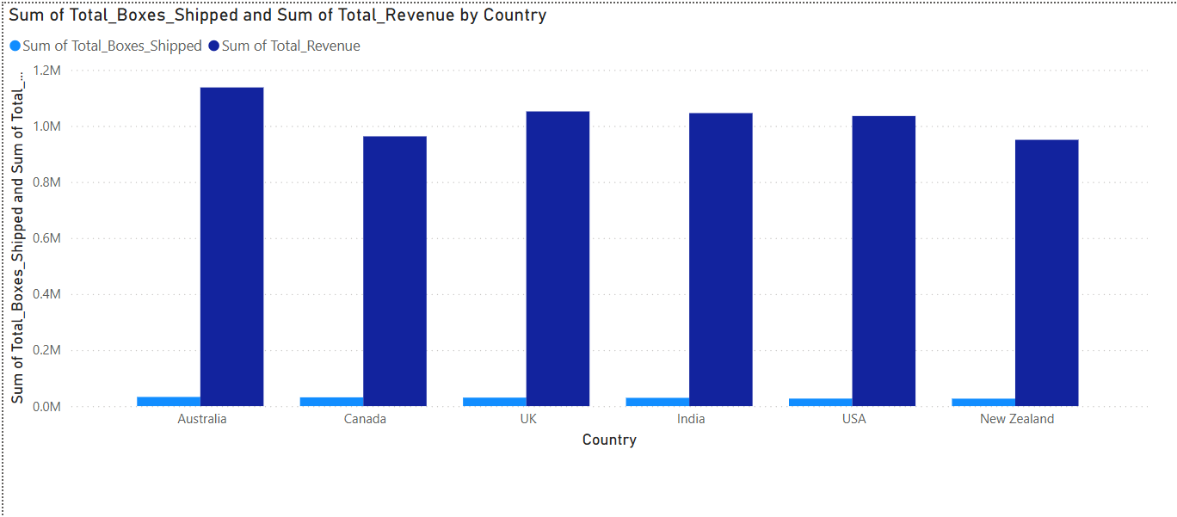
Country VS sum of total boxes shipped and total revenue
What should we do after analysis:
Based on the data, we should focus more on UK, India, and USA as they are mid-performing markets with strong growth potential if given more attention.
Attention Percentage:
Australia – 30%
Canada, New Zealand – 30%
UK, India, USA – 40% ✅ (Focus here)
Country-wise Performance Highlights:
🥇 Highest Total Revenue: Australia
🥉 Lowest Total Revenue: New Zealand
📦 Maximum Boxes Shipped: Australia
📦 Minimum Boxes Shipped: New Zealand

Slide 4
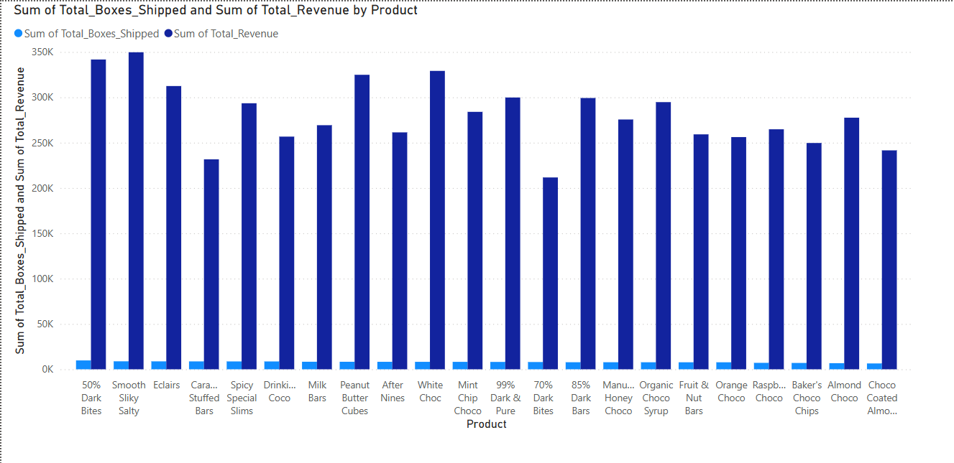
Products VS sum of total revenue and total boxes shipped
A
B
C
🏆 Top-Performing Products (Revenue > ₹300K):
50% Dark Bites, Smooth Silky Salty, Eclairs, Peanut Butter Cubes, White Choc
📉 Lowest Revenue Generator:
70% Dark Bites
Strategic Focus
According to the data, we should focus more on products with sales between ₹250K and ₹300K, as most products fall within this range.
Attention Allocation : High (A) = 25%
Medium (B) =50%
Low (C) = 25%

Slide 5
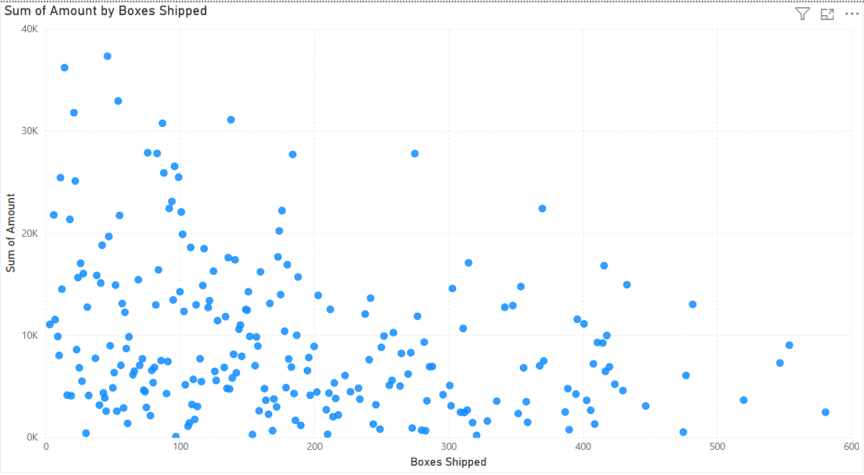
Boxes shipped VS Sum of amount
What Should We Do?
Based on the data, we should focus on orders where 0 to 300 boxes are shipped.
To boost engagement, we can introduce targeted offers within this range — especially in Section B where potential seems high.
Attention Distribution:
A: 35%
B: 35%
Others: 30%
B
A
According to the data, most of the boxes were shipped within the ₹0 to ₹10K range, with approximately 0 to 300 boxes ordered.

Slide 6
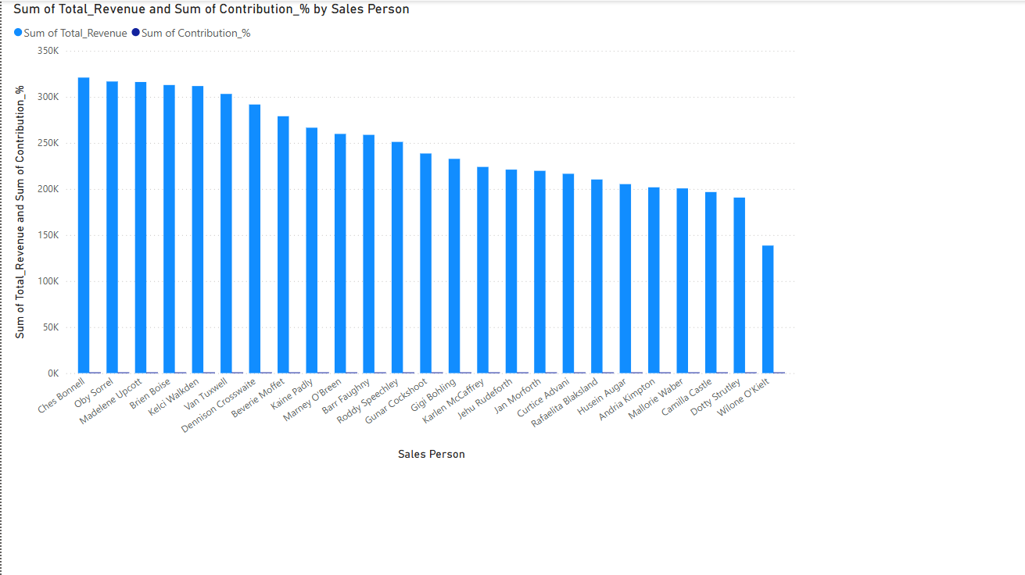
Sales person VS sum of total revenue and contribution %

Slide 7
Sales Performance Highlights
🔹 Top Performers (Revenue > ₹300K):
Ches Bonnell, Oby Sorrel, Madelene Upcott, Brien Boise, Kelci Walkden, Van Tuxwell
🔹 Lowest Revenue Generator: Wilone O’Kielt
Strategic Action Plan
📈 Deploy Top 6 Salespersons
To drive growth, we should assign our highest-performing salespersons to focus on Section B products.
🔍 Why?
These individuals are already generating maximum revenue. Leveraging their skills and insights can help us identify and resolve performance gaps in mid-performing areas like Section B — unlocking further growth potential.

Slide 8
Thank you for taking the time to explore this report.
Looking forward to your feedback! 😊

